Slide 1

Chinook Music Store Data Analysis presented by - Mousumi Gorai 20-July-2025

Slide 2
Introduction
This project analyzes the Chinook music store database, which simulates an online platform selling digital tracks and albums. Using MySQL, we explored customer demographics, sales trends, genre popularity, and album performance.
The objective is to uncover actionable insights that support data-driven decisions in marketing, customer targeting, and product promotion.
Data Source: Chinook Database
Tools Used: MySQL, Excel, PowerPoint
Focus Areas: Customers, Invoice, Tracks, Genres, Albums

Slide 3
Goals and Objectives
Understand customer demographics and geographic distribution.
Identify top-selling genres, tracks, and artists.
Analyze purchasing patterns and frequency of customer transactions.
Develop personalized marketing campaigns based on customer preferences and purchase history.
Analyze the impact of factors like price, release date, and promotions on customer purchasing decisions.

Slide 4
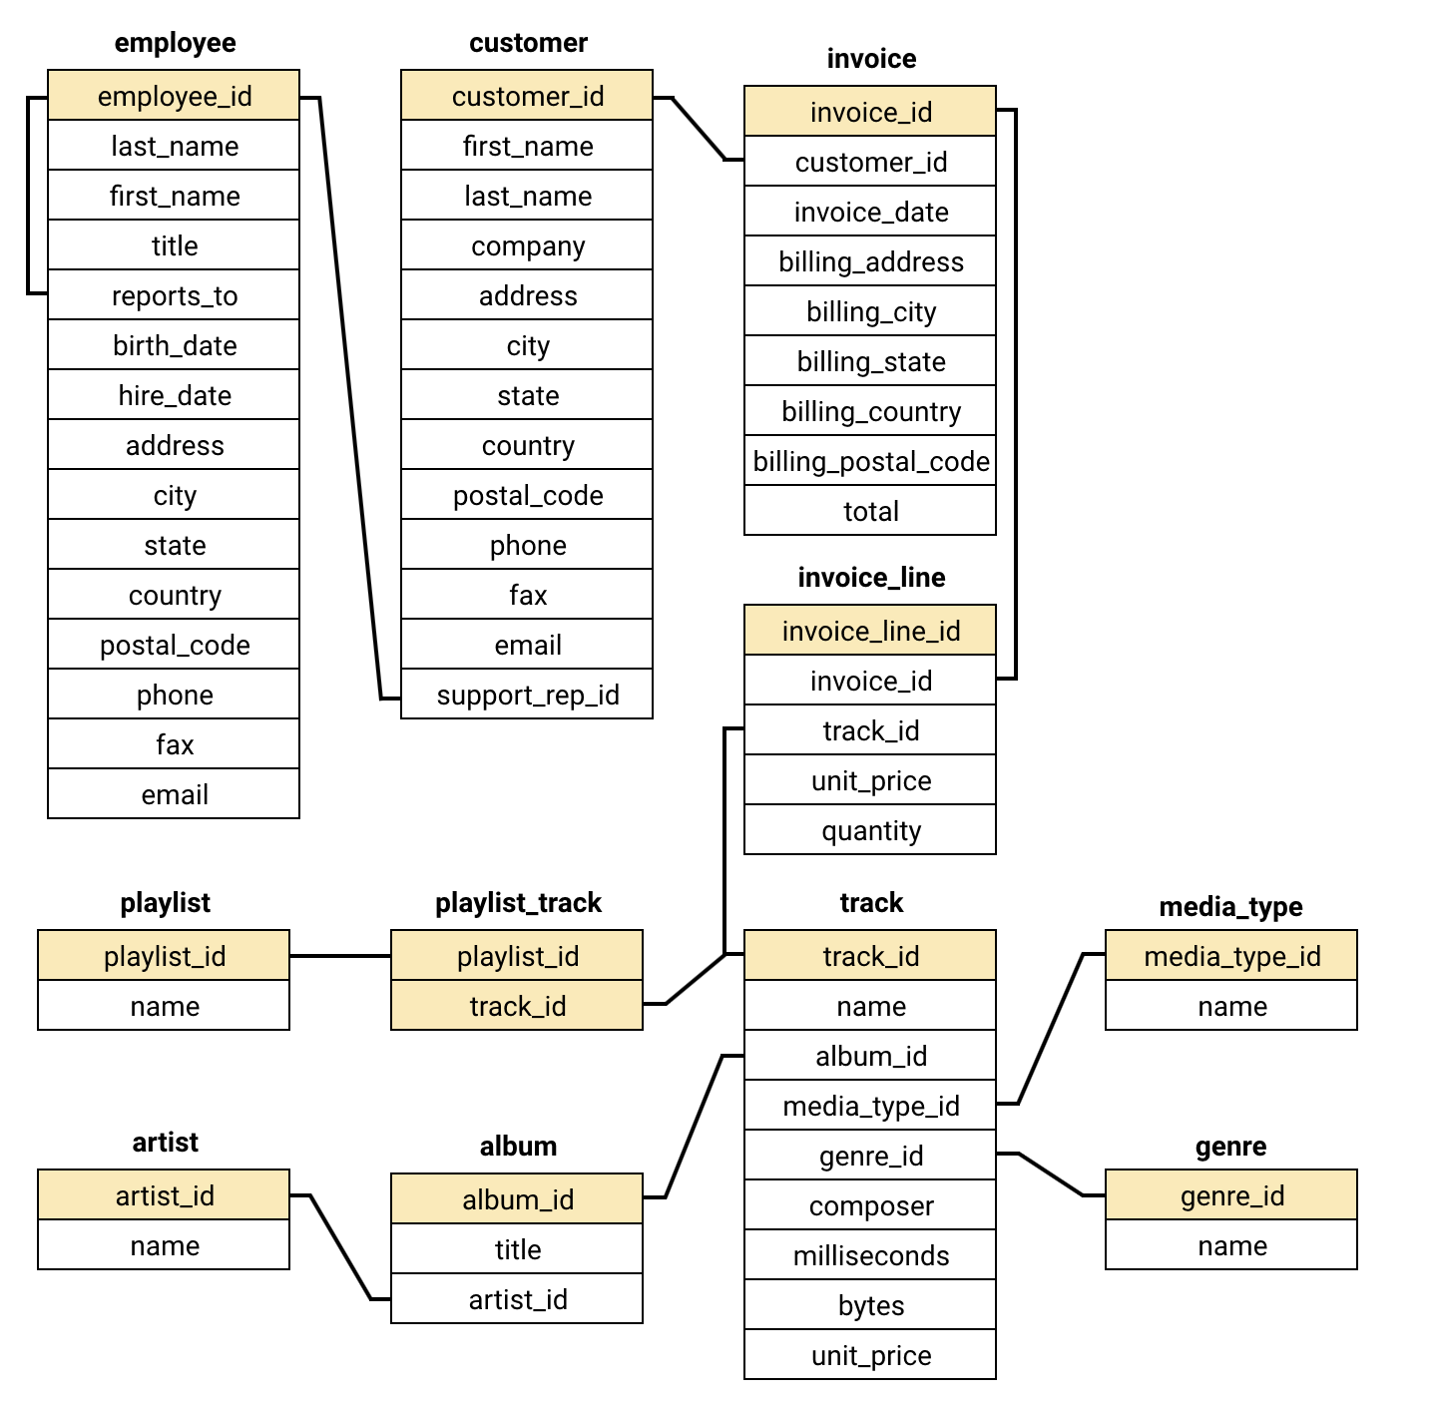
Data Base Schema

Slide 5
Customer Distribution by Country
The USA has the highest number of customers (13 out of 59 total), accounting for ~22% of the customer base.
Other major contributors : Canada (8 customers)France & Brazil (5 each)Germany & UK (4 each)
Opportunity to focus marketing on countries with moderate engagement like France, Brazil, and Germany.
Recommendation:
Focus on increasing engagement in countries with a small customer base to strengthen global presence.

Slide 6
Total revenue each country
The USA has the highest total revenue, amounting to 1040.49 million, followed by Canada with 535.59 million and Brazil with 427.68 million.
The country with the lowest total revenue among all others is Denmark, with total revenue of 37.62 million.
Recommendation:
Boost key markets: Focus on USA & Canada for continued revenue growth.
Grow mid-tier markets: Use promotions and bundles in France, Germany, and UK.
Target low-revenue regions: Test localized offers to improve engagement.

Slide 7
Top Selling Tracks in the USA
"War Pigs" is the best-selling track with 6 purchases.
Followed by "You Know I'm No Good" with 5 purchases.
Other top tracks (4 sales each):
"I Looked At You“
"Scentless Apprentice“
"Violent Pornography“
These tracks reflect strong interest in rock and alternative genres among U.S. customers.
Recommendation:
Focus marketing efforts in the U.S. on popular rock/alternative tracks and offer bundled playlists or discounts on related albums to drive more sales.

Slide 8
Top selling genre in countries other than usa
Having established that the USA is our top country in sales, we are now examining the top genres in other countries.
Across most countries, Rock is the top-selling genre. Countries like Brazil, Canada, France, and the United Kingdom show particularly high sales in Rock, demonstrating its universal appeal beyond the USA.
Recommendation:
Focus international promotion efforts primarily on Rock music, given its consistent top ranking across diverse markets.
Consider localized marketing strategies for countries like Argentina and Australia, where Alternative & Punk shows stronger performance.

Slide 9
Customer Purchase Frequency & Avg Order Value
František Wichterlová has the highest number of purchases (18 total orders).
Several customers have 12–16 purchases, showing a consistent buying pattern.
Customer with highest average order value: François Tremblay with $11.11, followed by HelenaHoly ($10.73).Some customers have high purchase count but low order value, and vice versa.
Recommendation:
Reward frequent buyers (like František Wichterlová) with loyalty points or early access offers.
Target high order value customers for premium subscriptions or bundle deals.

Slide 10
Average Total Spent by Country
Countries like Ireland and Czech Republic have high-spending individual customers, indicating high-value potential even with a small base.
USA has volume, but not the highest spend per person → shows broad reach but lower per-customer revenue.
Brazil shows both decent count and spend → a balanced opportunity.
Recommendations:
Nurture high-value markets (Ireland, Czech Republic) with personalized, premium offers—even if customer count is low.
Increase customer value in large markets like USA with upsells, bundles, and loyalty rewards.
Replicate Brazil's balance of volume and spend in similar markets through targeted campaigns.

Slide 11
Final Conclusion & Recommendations
Conclusion:
The USA has the largest customer base and highest sales, but lower average spend per customer.
Countries like Ireland and Czech Republic show high average spending, indicating valuable niche markets.
Customers vary in purchase frequency vs order value — both are important
.Certain tracks and genres consistently outperform others, especially in the USA.
Recommendations:
Focus on customer retention in large markets (USA, Canada) through loyalty programs.
Launch premium campaigns in high-value countries (Ireland, Czech Republic).
Segment customers by purchase behavior for personalized targeting (frequent buyers vs high spenders).
Invest in top-performing genres (rock/alternative) to drive revenue further .
Use country-level insights to tailor marketing strategies by region.

Slide 12
Thank You

